Slide 1
WELCOME EVERYONE

Slide 2
UNIVERSITY MANAGEMENT SYSTEM (UMS)

Slide 3
HELLO!
WE ARE TEAM - 6
SECTION – 06 INTAKE - 44
IFTEKHAR AHAMED SIDDIQUEE
SUPERVISOR
ID: 19202103239
Meer Muttakin Alam
Teacher Assistant Department Of Computer Science
And Engineering
SUMI AKTER
ID: 19202103205
DIPTA KUMAR SAHA
ID: 19202103216
3

Slide 4
Project Review
Background
Advantages
System Requirements
Project Model
Program Feature
Feature Details
Future work
Conclusion
4

Slide 5
INTRODUCTION
UNIVERSITY MANAGEMENT SYSTEM
Student Details.
Employee Details.
Teacher Details.
Notice.
Academic Related Reports.
Course Details.
Registration.
Communication.
5

Slide 6
OBJECTIVE
To become a non-stop data center.
To reduce paper work.
To reduce work in mind.
Build a communication between teacher
and student.
Make secured data.
6

Slide 7
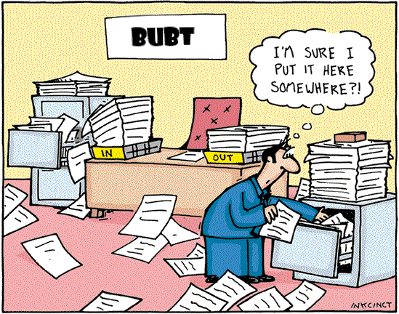
Problem Definition
3000+ Student
200+ Teacher
100+ Employee
5+ Department
7

Slide 8

ADVANTAGES
Less human error.
Fast search.
Strength and strain of registers and papers can be reduced.
High security.
Data consistency.
Easy to handle.
Easy data updating.
Easy record keeping.
Backup data .
Easy Registration .
Easy Communication.
8

Slide 9








System Requirements
HARDWARE REQUIREMENTS
(Minimum Requirement)
Minimum Ram : 1 GB OR MORE
Hard Disk : -40 GB or more
Processor :-Intel Pentium 3 or above
SOFTWARE REQUIREMENTS
(Minimum Requirement)
.
.Windows 2000/2008/2010/NT/XP/Vista
Code blocks
Standard C Compiler
Latex
GitHUB
9

Slide 10
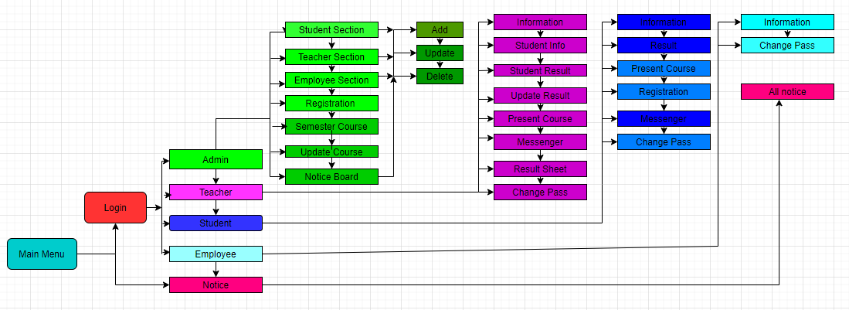
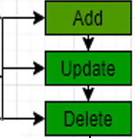
PROJECT MODEL
search
10

Slide 11
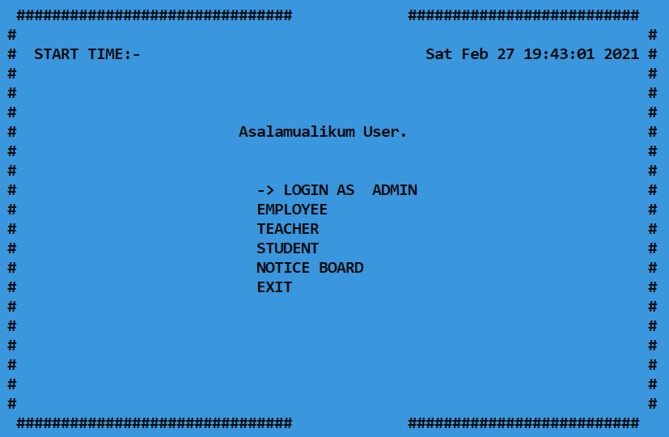
Program Feature
ADMIN
TEACHER
STUDENT
EMPLOYEE
NOTICE
11

Slide 12
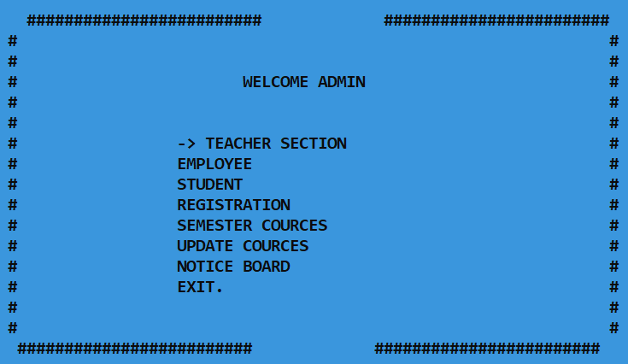
Feature Details
ADMIN
TEACHER
EMPLOYEE
STUDENT
REGISTRATION
SEMESTER COUR
-CES
UPDATE COURCES
NOTICE BOARD
12

Slide 13
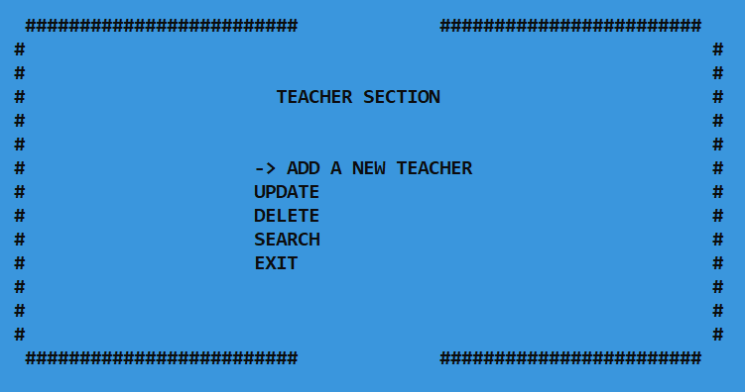
Feature Details
ADMIN-TEACHER
ADD A NEW TEACHER
UPDATE A TEACHER
DELETE A TEACHER
SEARCH A TEACHER
13

Slide 14
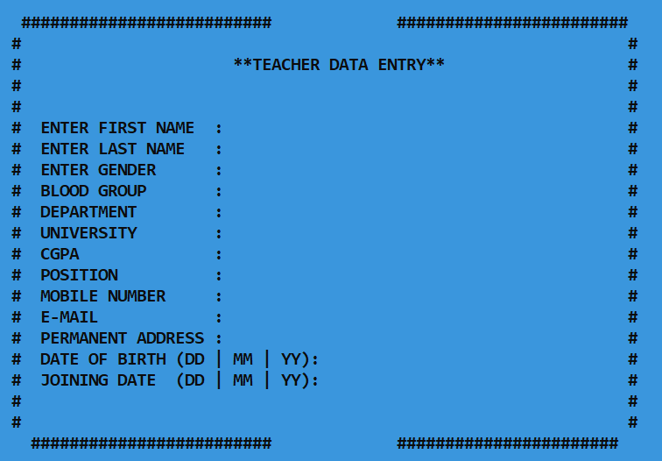
Feature Details
ADMIN-teacher-add new teacher
ADD NEW TEACHER
14

Slide 15
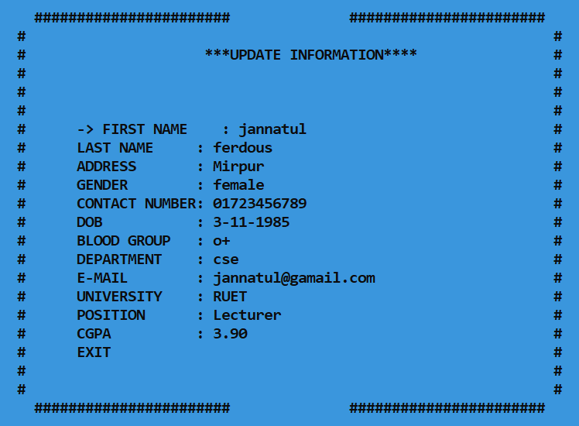
ADMIN-teacher-update teacher
UPDATE TEACHER
15

Slide 16
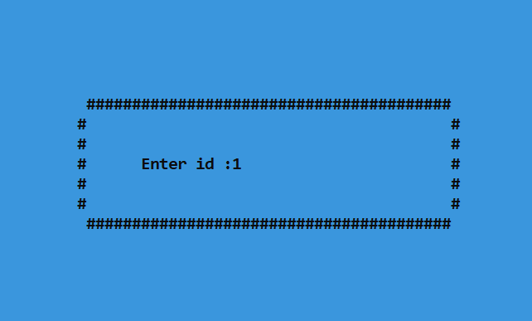
ADMIN-teacher-DELETE teacher
DELETE TEACHER
ID
CONFIRMATION
DELETE
16

Slide 17
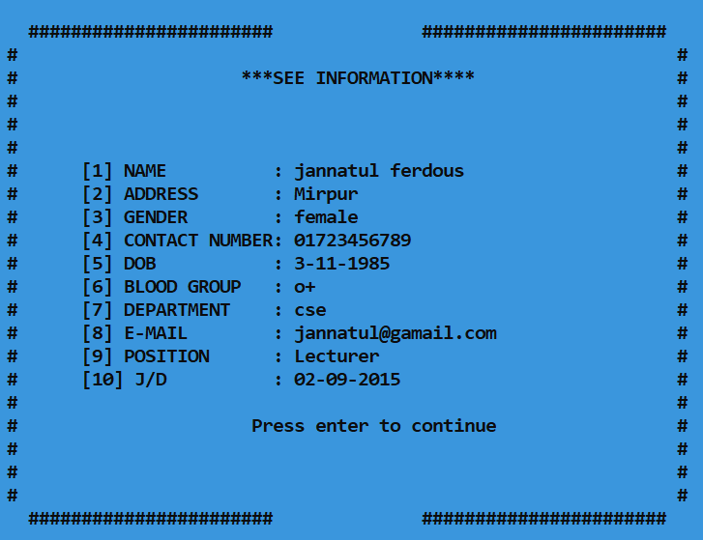
ADMIN-teacher-search teacher
SEARCH TEACHER
ID
SEE DATA
17

Slide 18
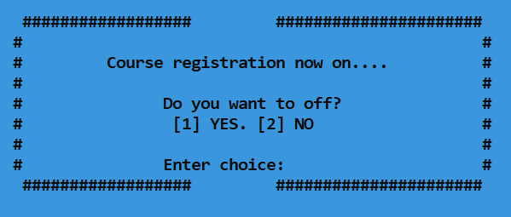
ADMIN-registration
REGISTRATION PROCESS
18

Slide 19
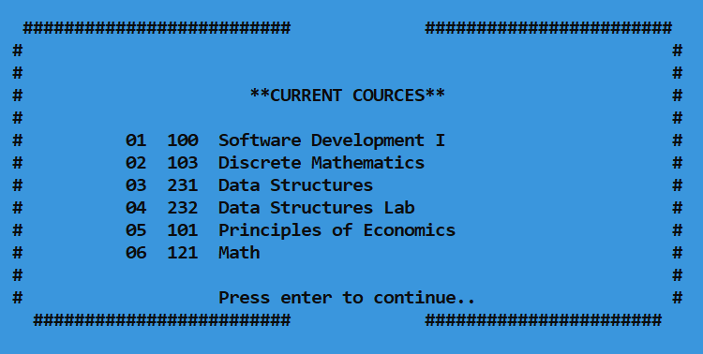
ADMIN-current course
SEE CURRENT COURSES
INTAKE
SEE COURSE
19

Slide 20
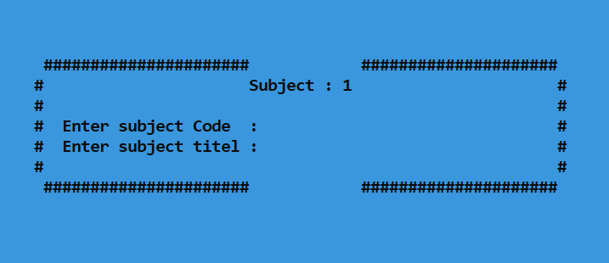
ADMIN-EDIT/CREATE course
CREATE/EDIT COURSES
INTAKE
Quantity
20

Slide 21
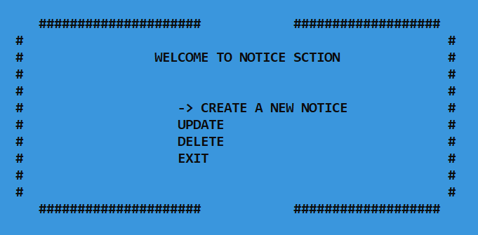
ADMIN-notice
CREATE A NEW NOTICE
UPDATE A NOTICE
DELETE A NOTICE
21

Slide 22
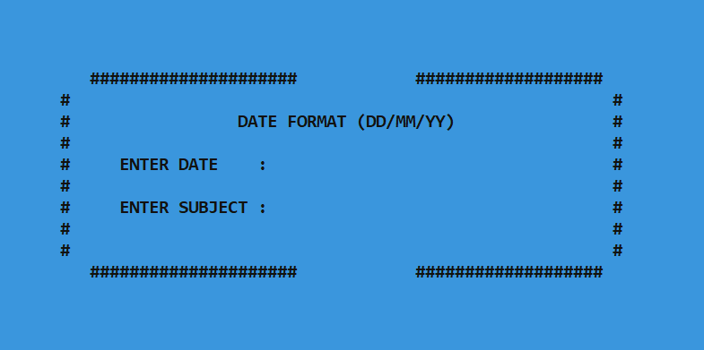
ADMIN-notice-create-update-delete
CREATE A NEW NOTICE
UPDATE A NOTICE
DELETE A NOTICE
22

Slide 23
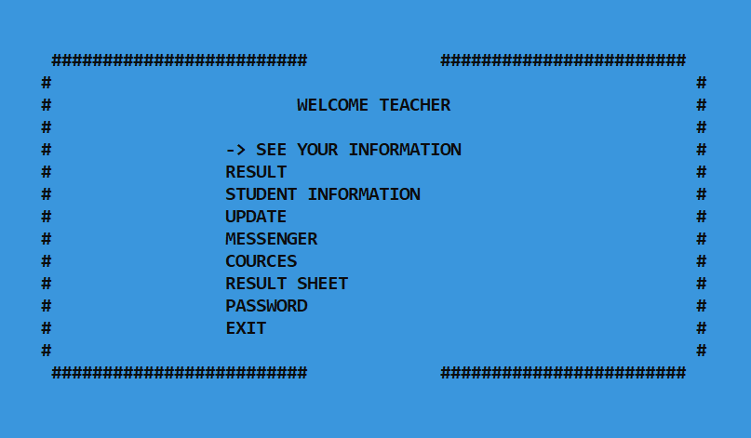
TEACHER
SEE INFORMATION
SEE STUDENT RE
-SULT
SEE STUDENT INF
-ORMATIOM
UPDATE STUDENT
RESULT
MESSENGER
MAKE A RESULT SH
-EET
CHANGE PASSWO
-RD
23

Slide 24
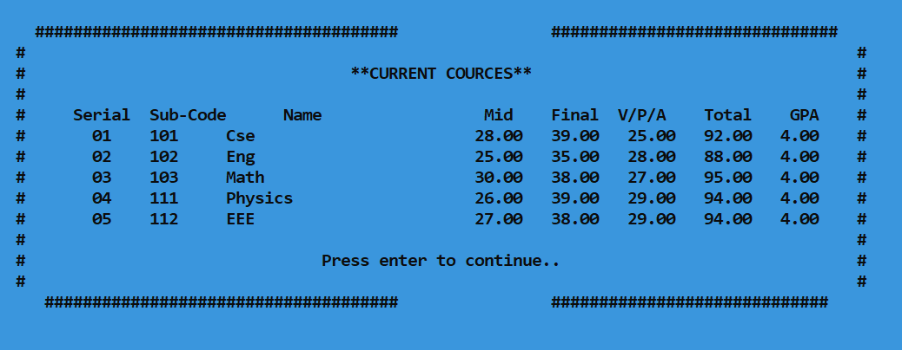
teacher - STUDENT RESULT
STUDENT RESULT
ID
SEE DATA
24

Slide 25
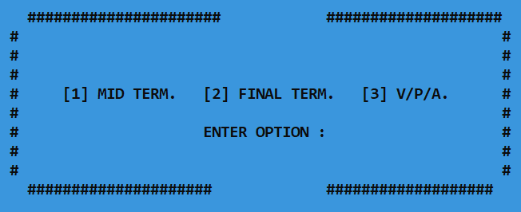
teacher - UPDATE STUDENT RESULT
UPDATE STUDENT RESULT
ID
INTAKE
SUBJECT CODE
SEMESTER
25

Slide 26
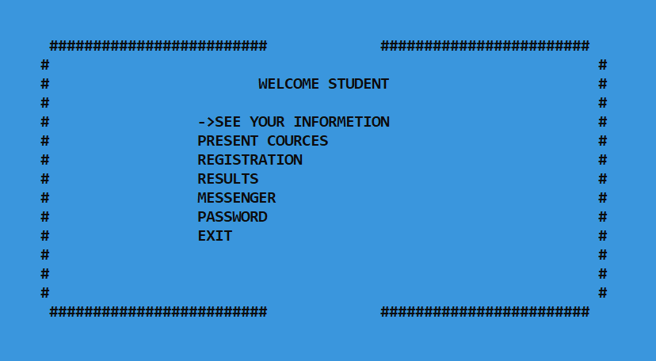
STUDENT
SEE INFORMATION
SEE PRESENT COU
-RSE
COURSE REGISTR
-ATION
SEE RESULT
MESSENGER
CHANGE PASSWO
-RD
26

Slide 27
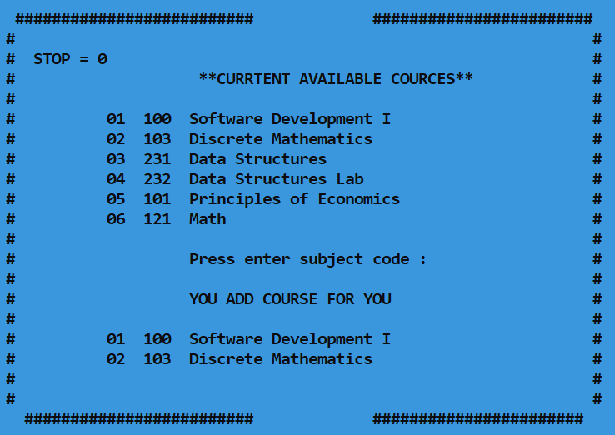
STUDENT – COURSE REGISTRATION
COURSE REGISTRATION
27

Slide 28
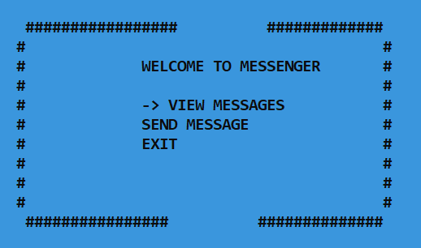
MESSENGER
MESSENGER
28

Slide 29
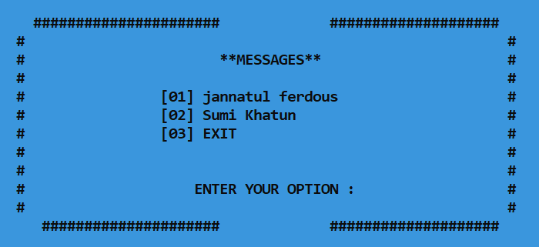
MESSENGER-VIEW MESSAGE
VIEW MESSAGE
29

Slide 30
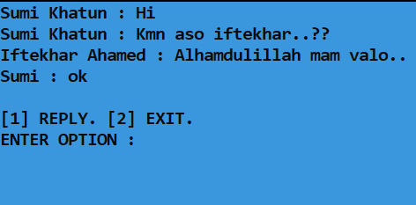
MESSENGER-Send message
SEND MESSAGE
30

Slide 31
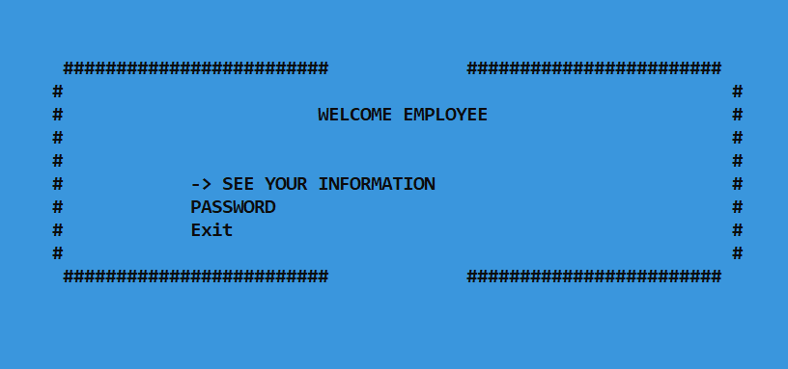
employee
SEE INFORMATION
CHANGE PASSWORD
31

Slide 32
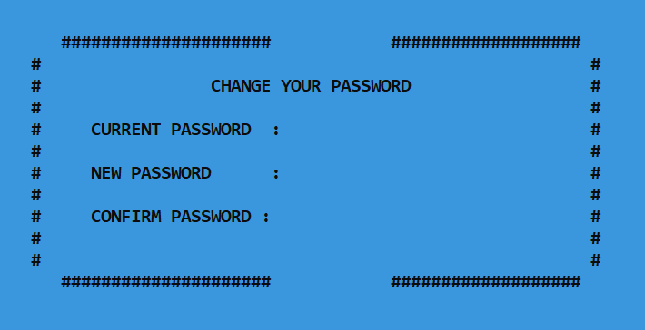
CHANGE PASSWORD
CHANGE PASSWORD
32

Slide 33
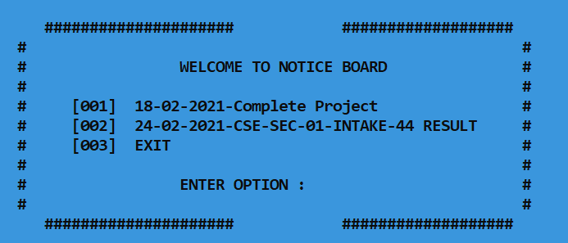
NOTICE BOARD
SEE NOTICE
33

Slide 34

Future plan
Web-based.
Encryption Method.
User interface.
Accounts Section.
Library Section.
34

Slide 35
Conclusion
Helpful approach for the users
Reduces the time
User friendly approach.
Maintains communications between
student and teachers.
35

Slide 36
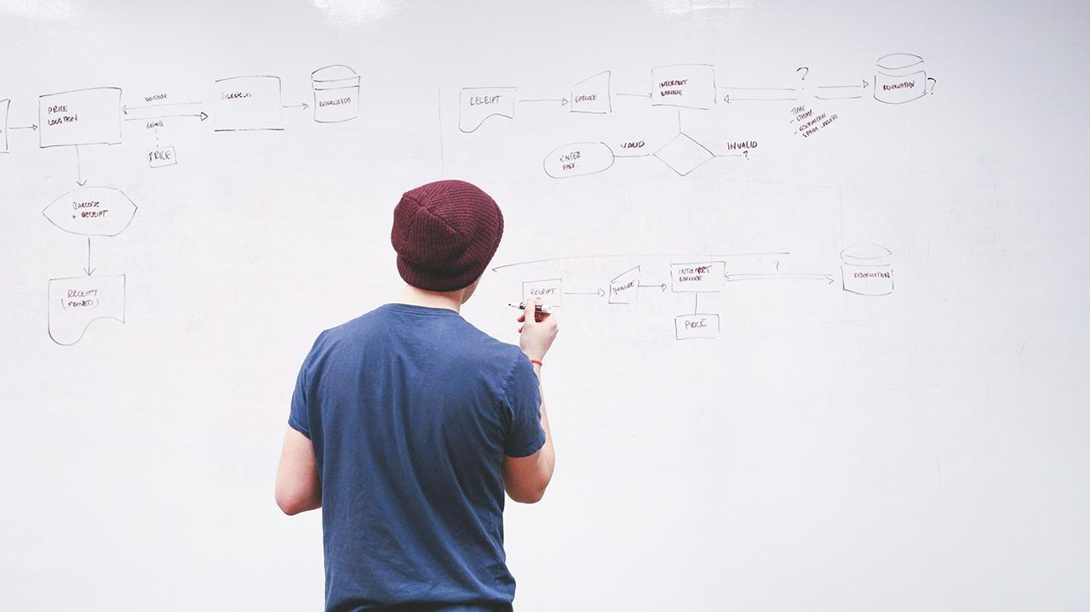
THANKS!
36

